Slide 1



International Skaters Union (ISU) Competition Report
View in Power BI
Last data refresh:
8/24/2023 12:06:35 AM UTC
Downloaded at:
8/24/2023 12:12:58 AM UTC

Slide 2
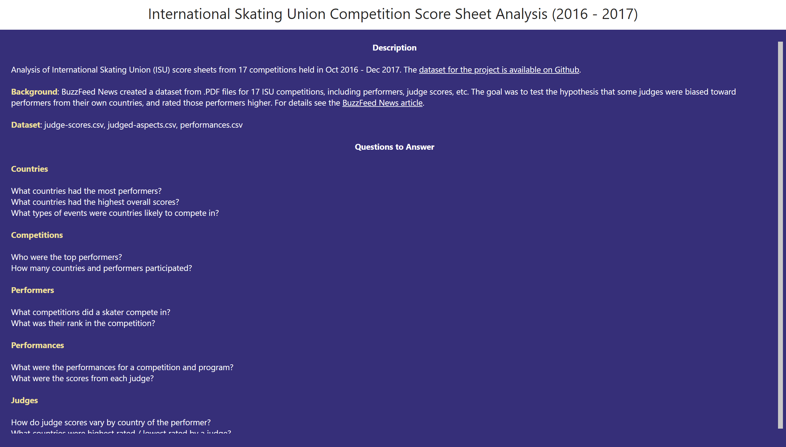
Introduction
Notes:
textbox
No alt text provided
textbox
No alt text provided

Slide 3
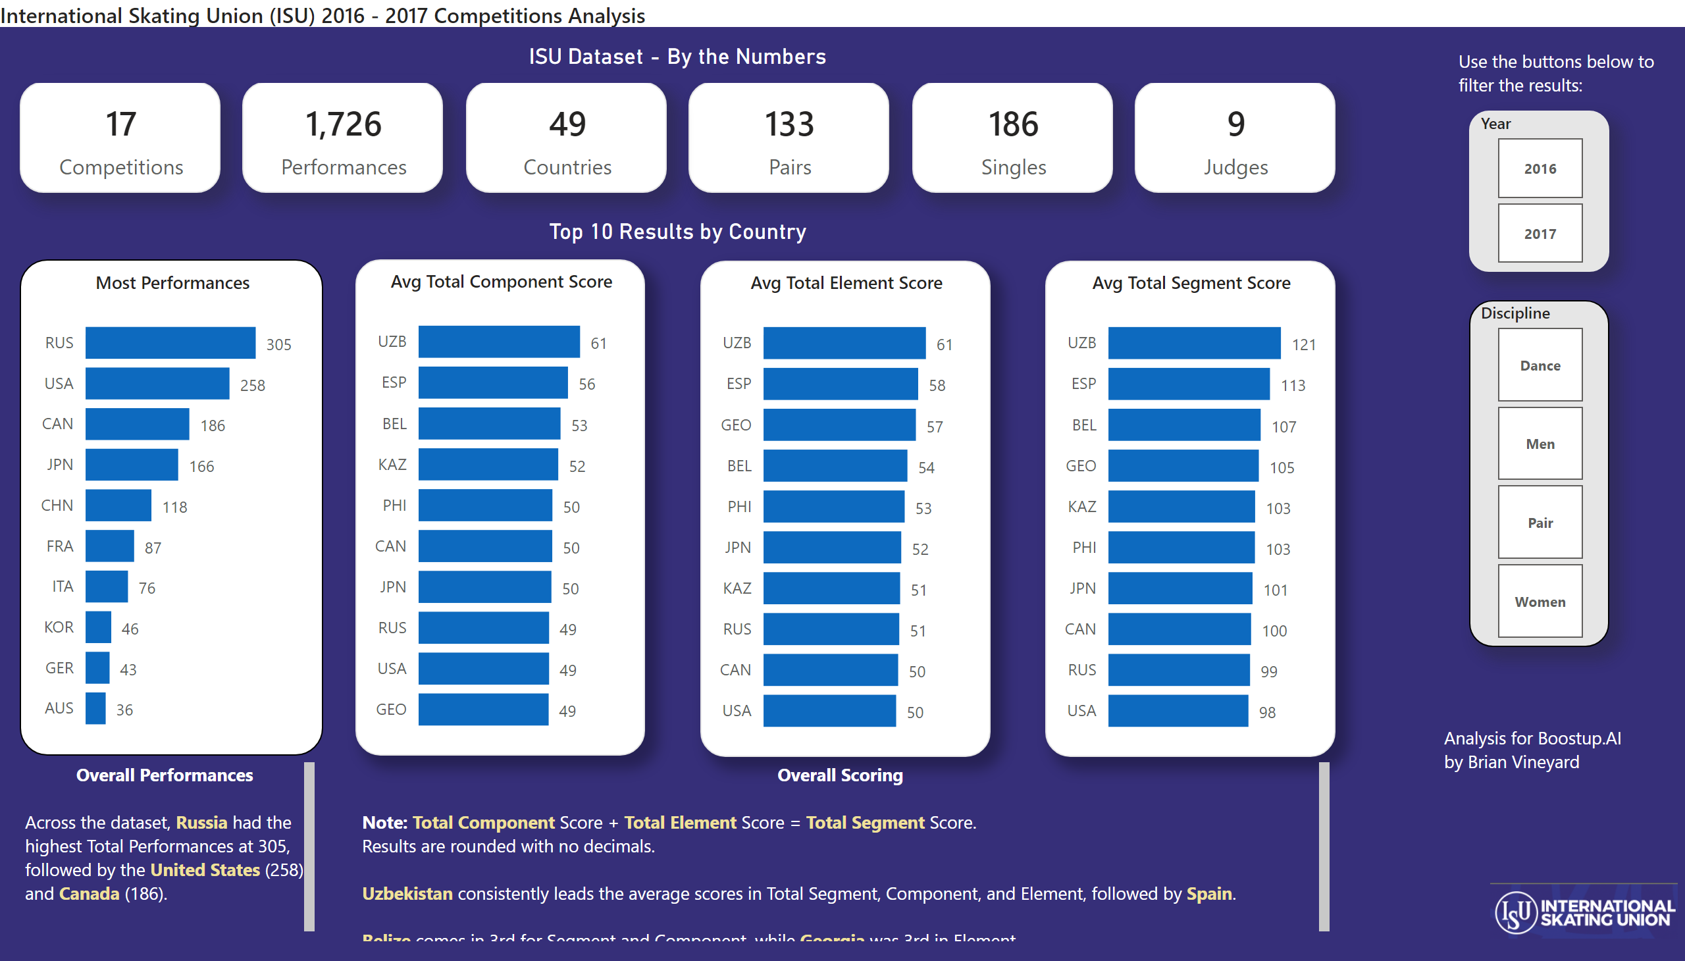
Overview
Notes:
Avg Total Segment Score
No alt text provided
card
No alt text provided
card
No alt text provided
card
No alt text provided
card
No alt text provided
card
No alt text provided
image
No alt text provided
International Skating Union (ISU) 2016 - 2017 Competitions Analysis
No alt text provided
textbox
No alt text provided
slicer
No alt text provided
slicer
No alt text provided
Most Performances
No alt text provided
Top 10 Results by Country
No alt text provided
Avg Total Component Score
No alt text provided
Avg Total Element Score
No alt text provided
card
No alt text provided
ISU Dataset - By the Numbers
No alt text provided
textbox
No alt text provided
textbox
No alt text provided
textbox
No alt text provided

Slide 4
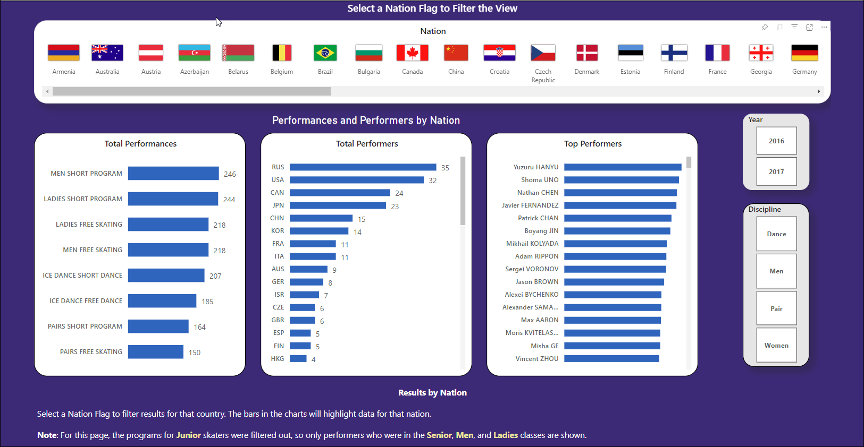

Slide 5
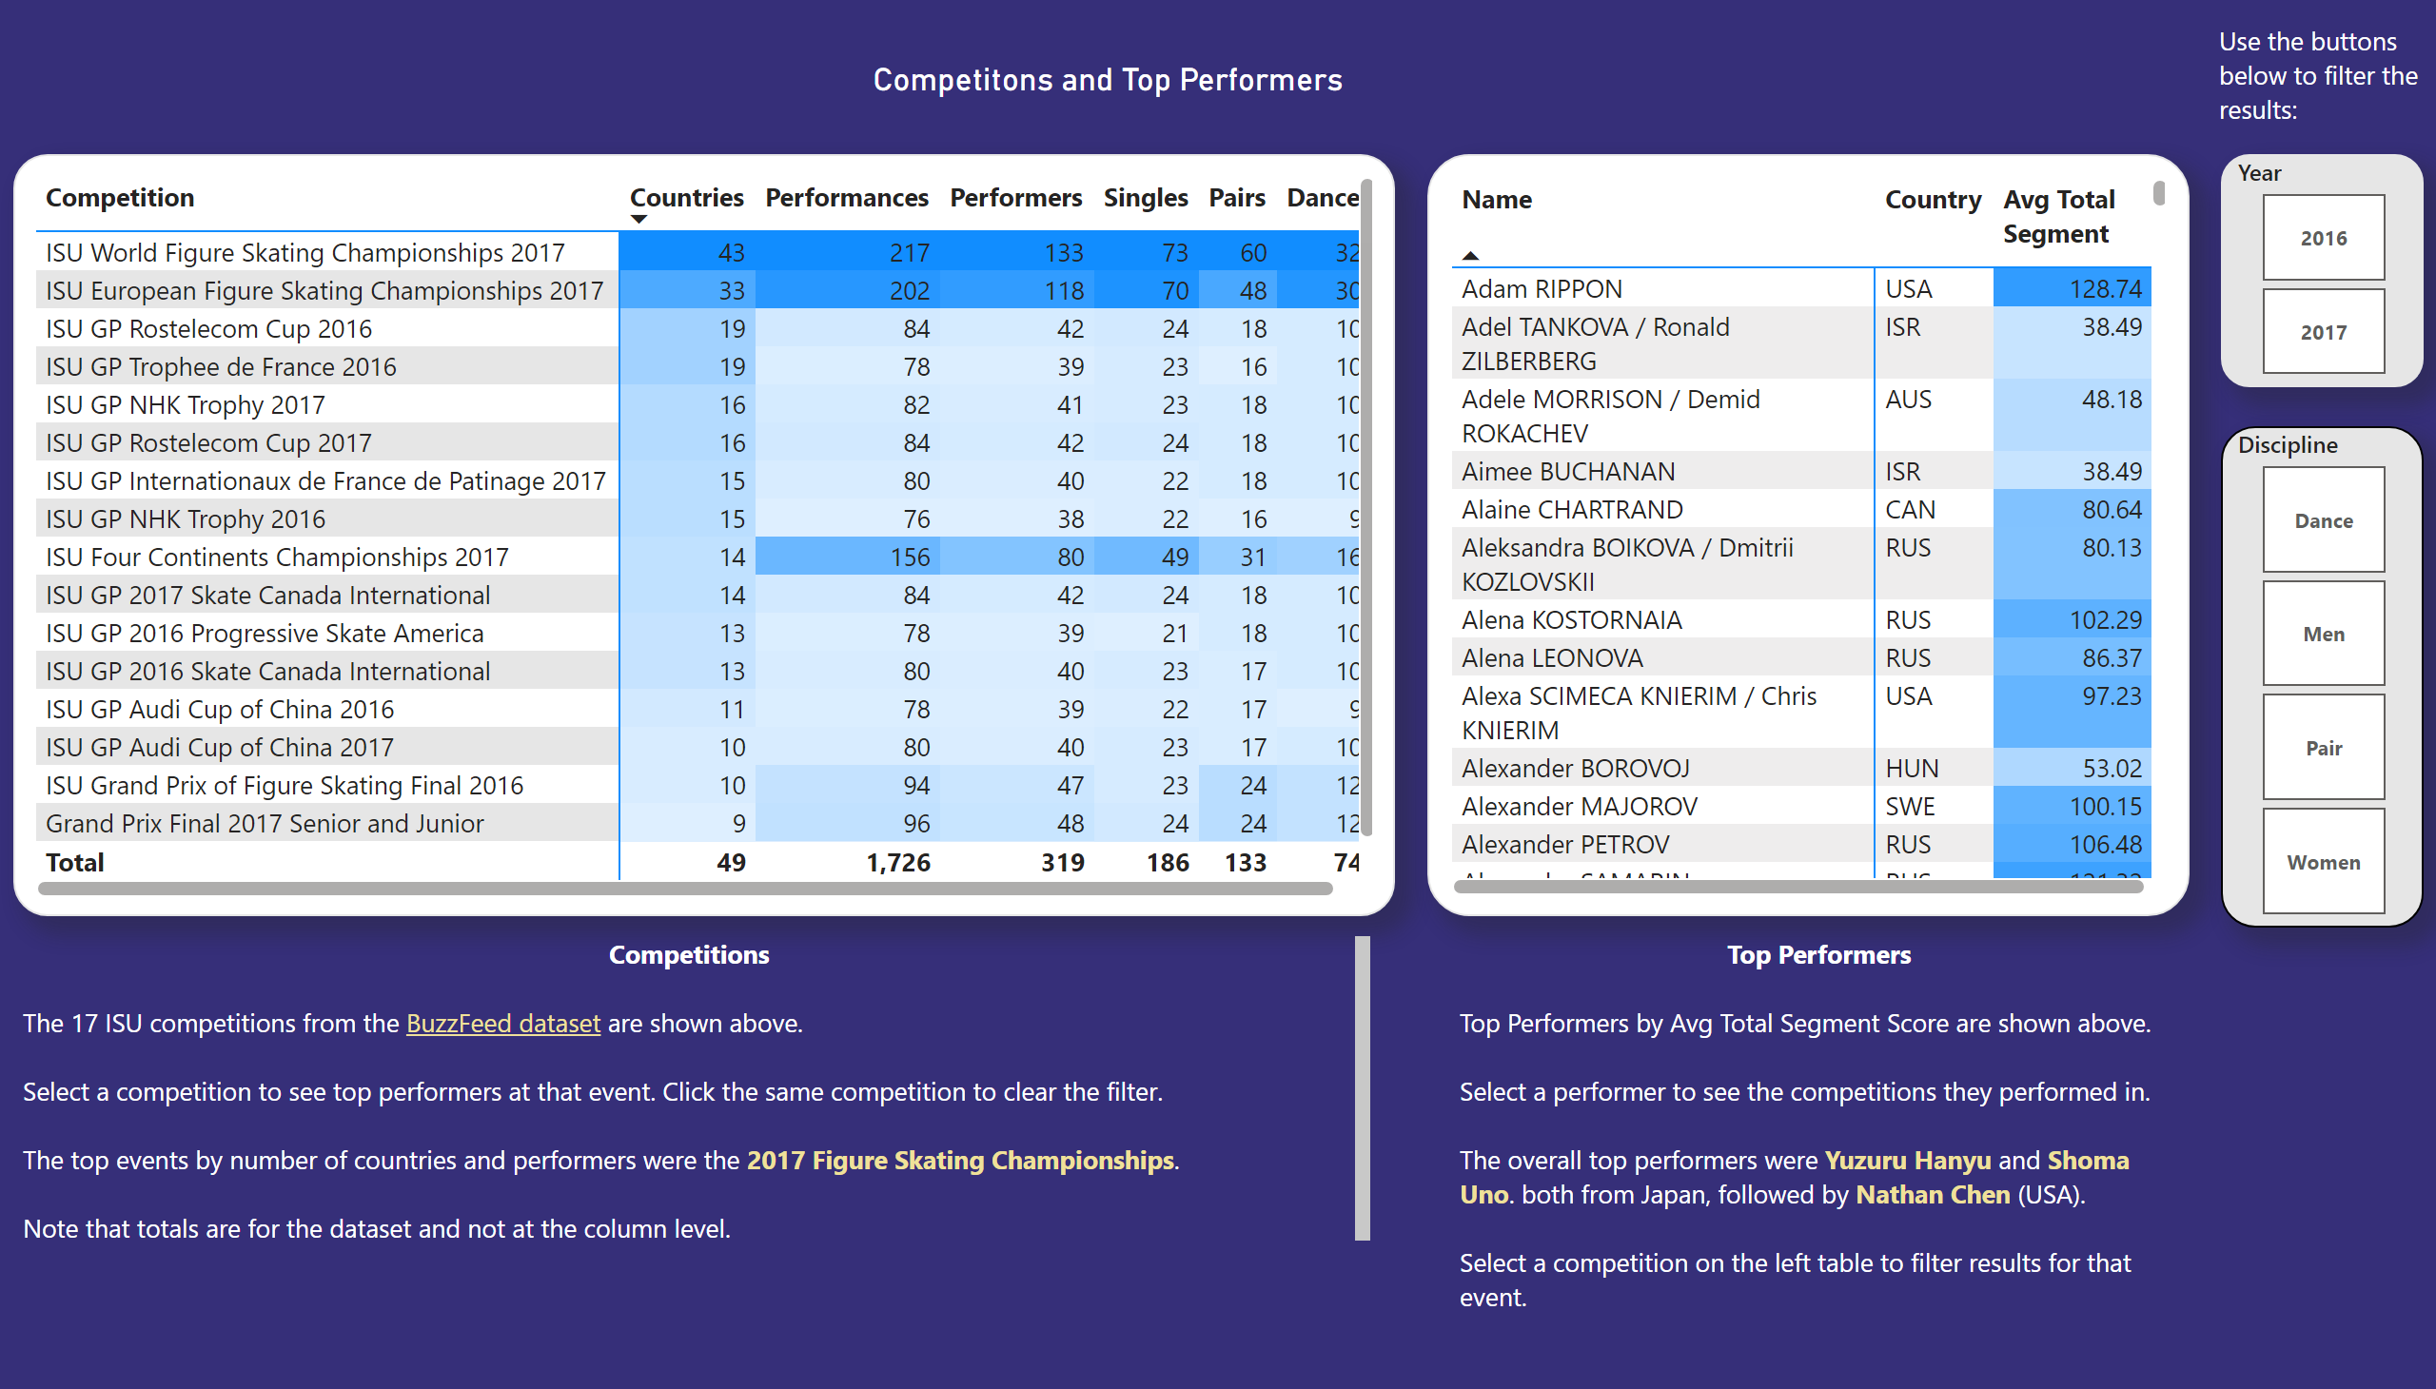
Competitions
Notes:
pivotTable
No alt text provided
textbox
No alt text provided
pivotTable
No alt text provided
textbox
No alt text provided
slicer
No alt text provided
slicer
No alt text provided
textbox
No alt text provided
Competitons and Top Performers
No alt text provided

Slide 6
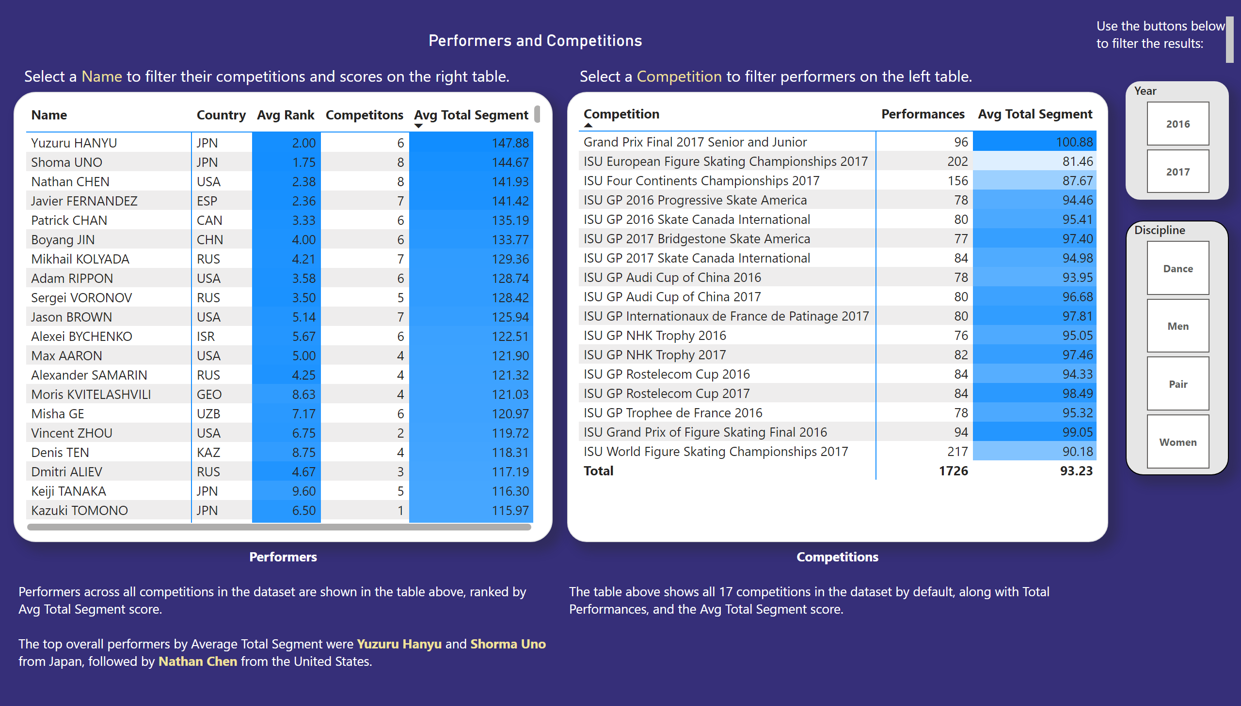
Performers
Notes:
pivotTable
No alt text provided
slicer
No alt text provided
slicer
No alt text provided
textbox
No alt text provided
Performers and Competitions
No alt text provided
pivotTable
No alt text provided
textbox
No alt text provided
textbox
No alt text provided
textbox
No alt text provided
textbox
No alt text provided

Slide 7
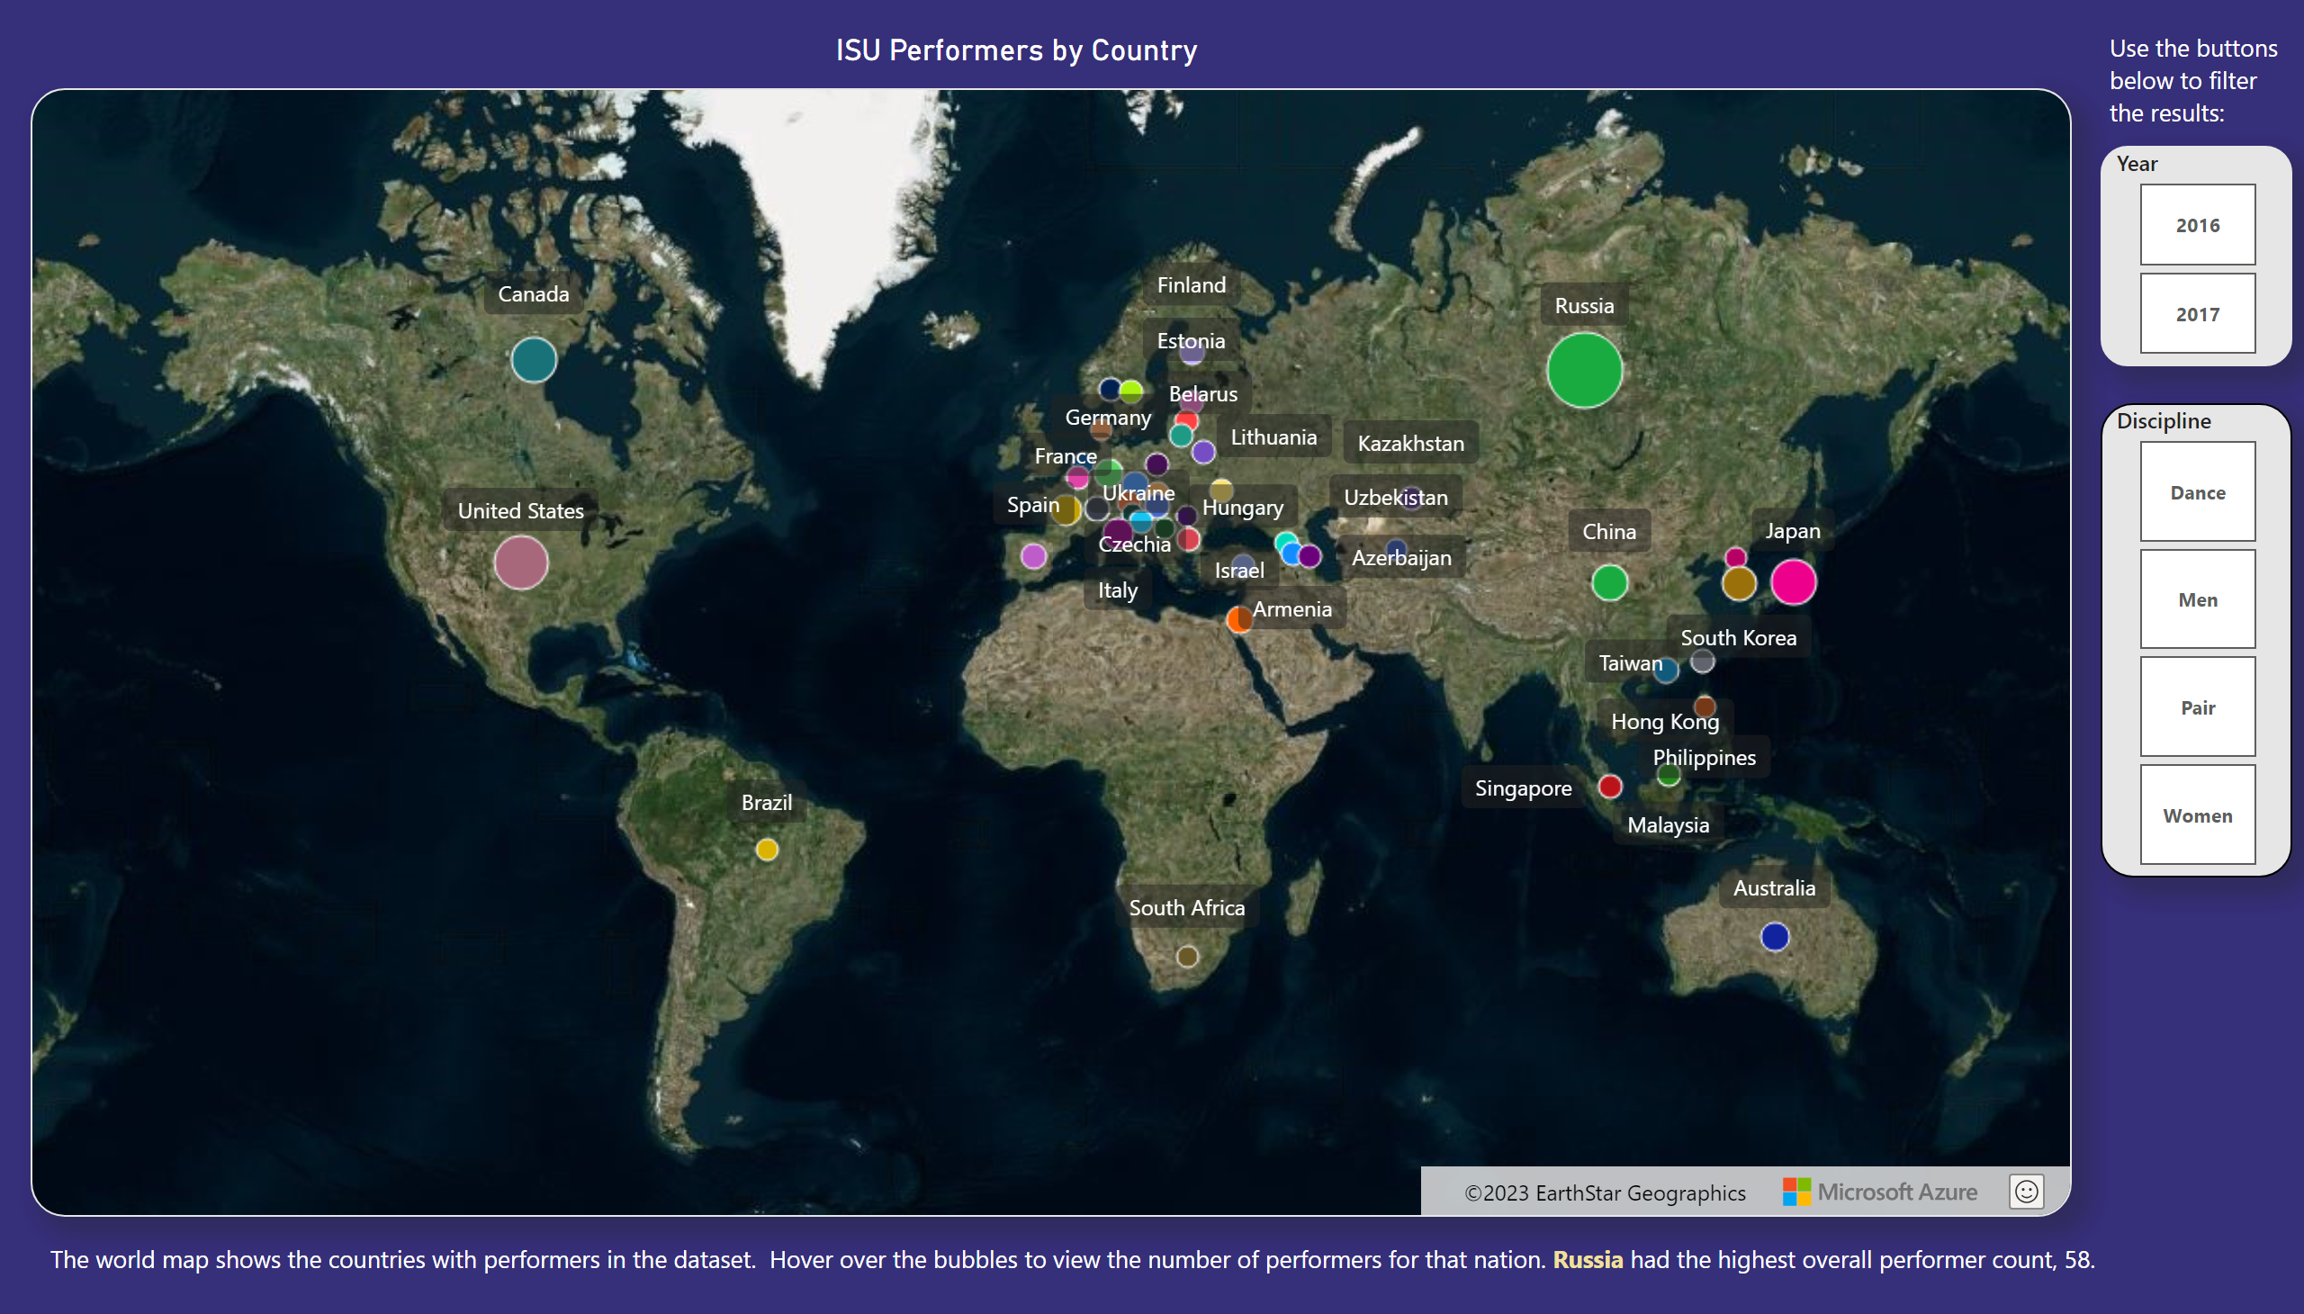
World Map of Performers
Notes:
ISU Performers by Country
No alt text provided
ISU Performers by Country
No alt text provided
slicer
No alt text provided
slicer
No alt text provided
textbox
No alt text provided
textbox
No alt text provided

Slide 8
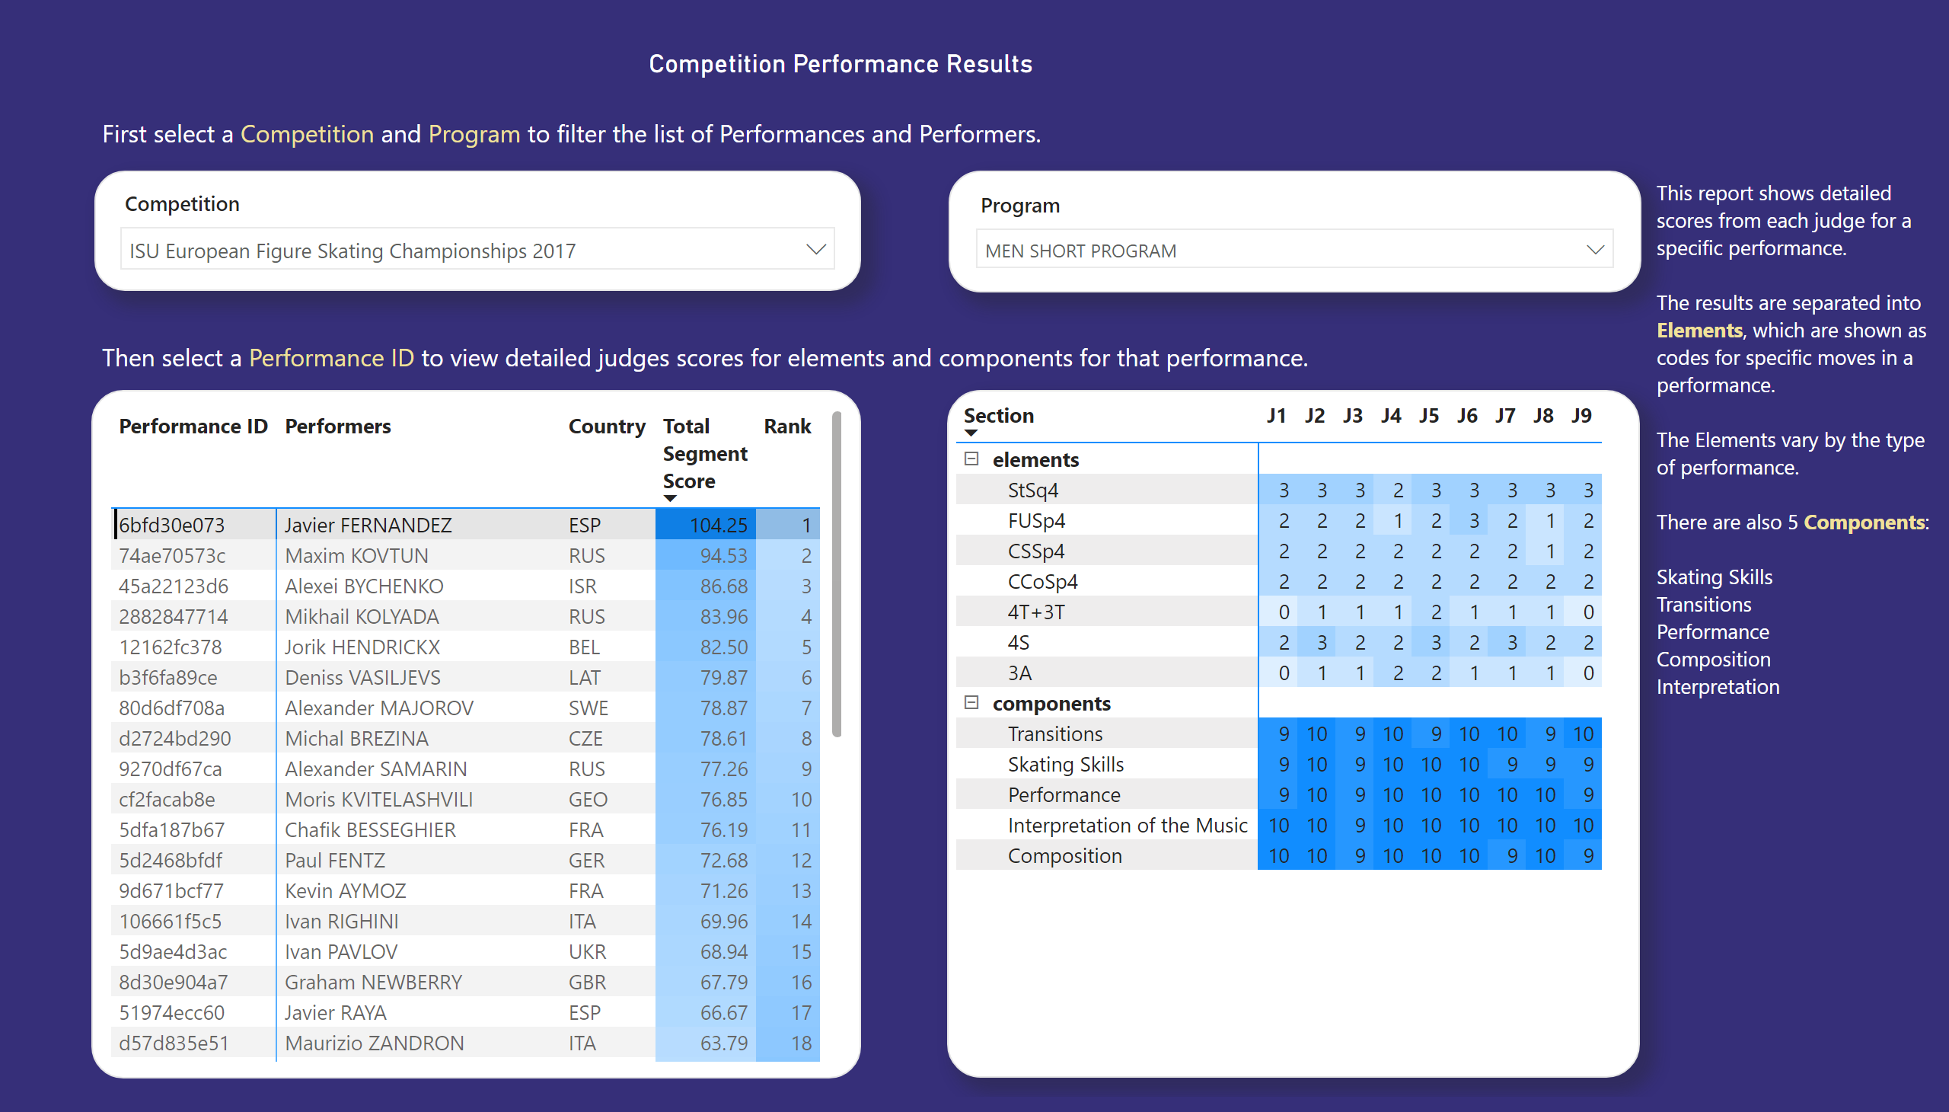
Performance Score Details
Notes:
Competition Performance Results
No alt text provided
slicer
No alt text provided
slicer
No alt text provided
pivotTable
No alt text provided
pivotTable
No alt text provided
textbox
No alt text provided
textbox
No alt text provided
textbox
No alt text provided

Slide 9
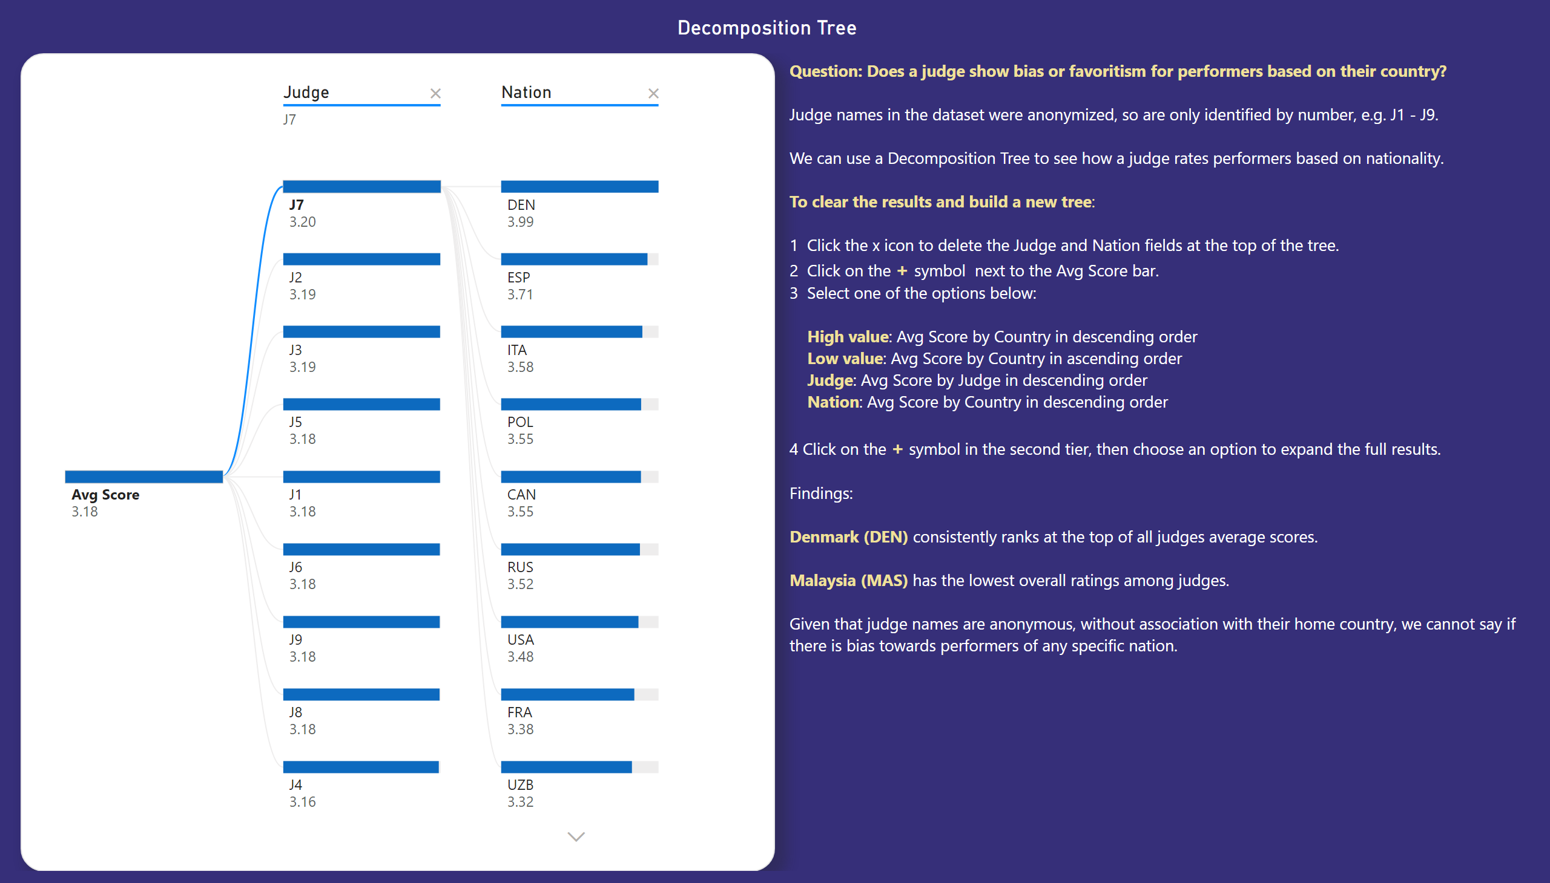
Decomposition Tree
Notes:
decompositionTreeVisual
No alt text provided
Decomposition Tree
No alt text provided
textbox
No alt text provided

